Slide 1


CYBER SECURITY
Module IV:Practical Security Concepts
Er. Prakash Chandra Adhikari

Slide 2
Learning Agenda
Introduction to practical security
Access control and authentication
Network and system security
Application and data security
Monitoring and incident response
Activities and next steps

Slide 3
What Are Practical Security Concepts?
Practical security focuses on implementing security controls
It translates theory into real-world protection mechanisms
Used to protect systems, networks, and data in practice

Slide 4
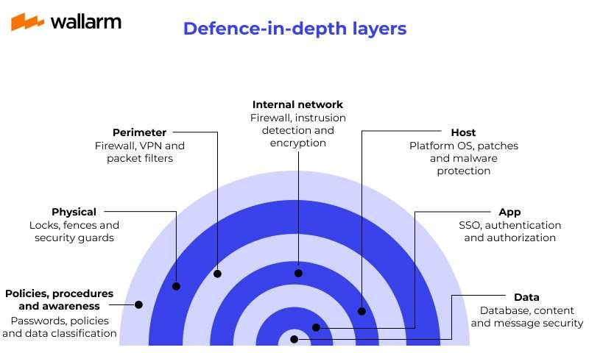
Defence-in-Depth Strategy

Slide 5
Defense-in-Depth Strategy
Uses multiple layers of security controls
Prevents single points of failure
Combines technical, administrative, and physical controls

Slide 6
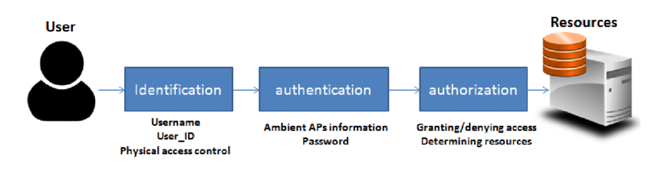
Access Control Fundamentals

Slide 7
Access Control Fundamentals
Access control restricts system access to authorised users
Based on identification, authentication, and authorisation
Reduces risk of unauthorised access

Slide 8
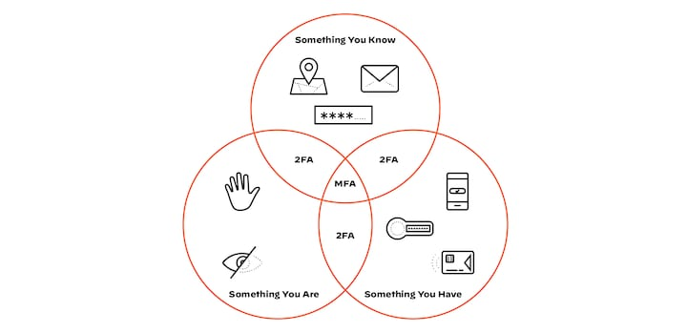
Authentication Mechanisms

Slide 9
Authentication Mechanisms
Something you know (passwords, PINs)
Something you have (tokens, smart cards)
Something you are (biometrics)

Slide 10
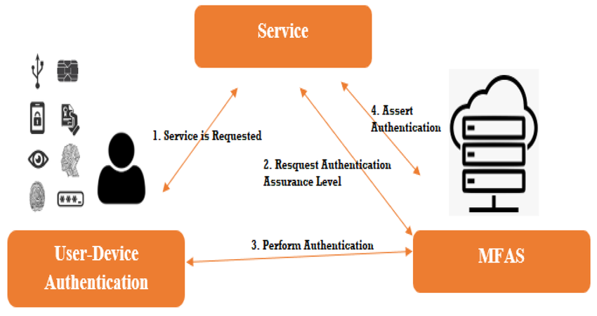
Multi-Factor Authentication (MFA)

Slide 11
Multi-Factor Authentication (MFA)
Combines two or more authentication factors
Greatly improves account security
Widely used in enterprise and cloud systems

Slide 12
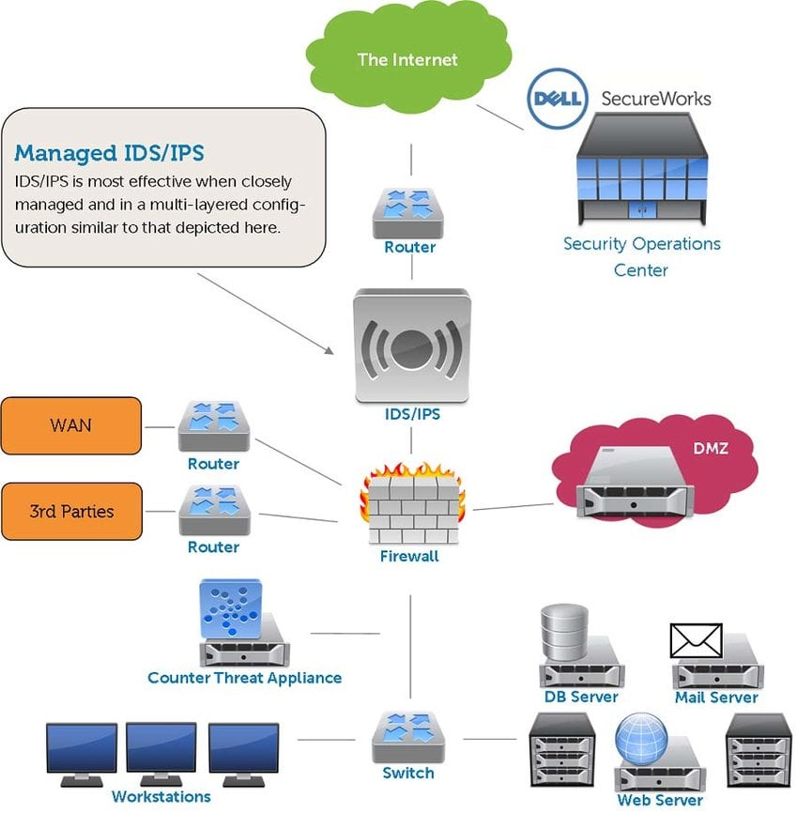
Network Security Controls

Slide 13
Network Security Controls
Firewalls control network traffic
Intrusion Detection and Prevention Systems monitor attacks
Segmentation limits attack spread

Slide 14
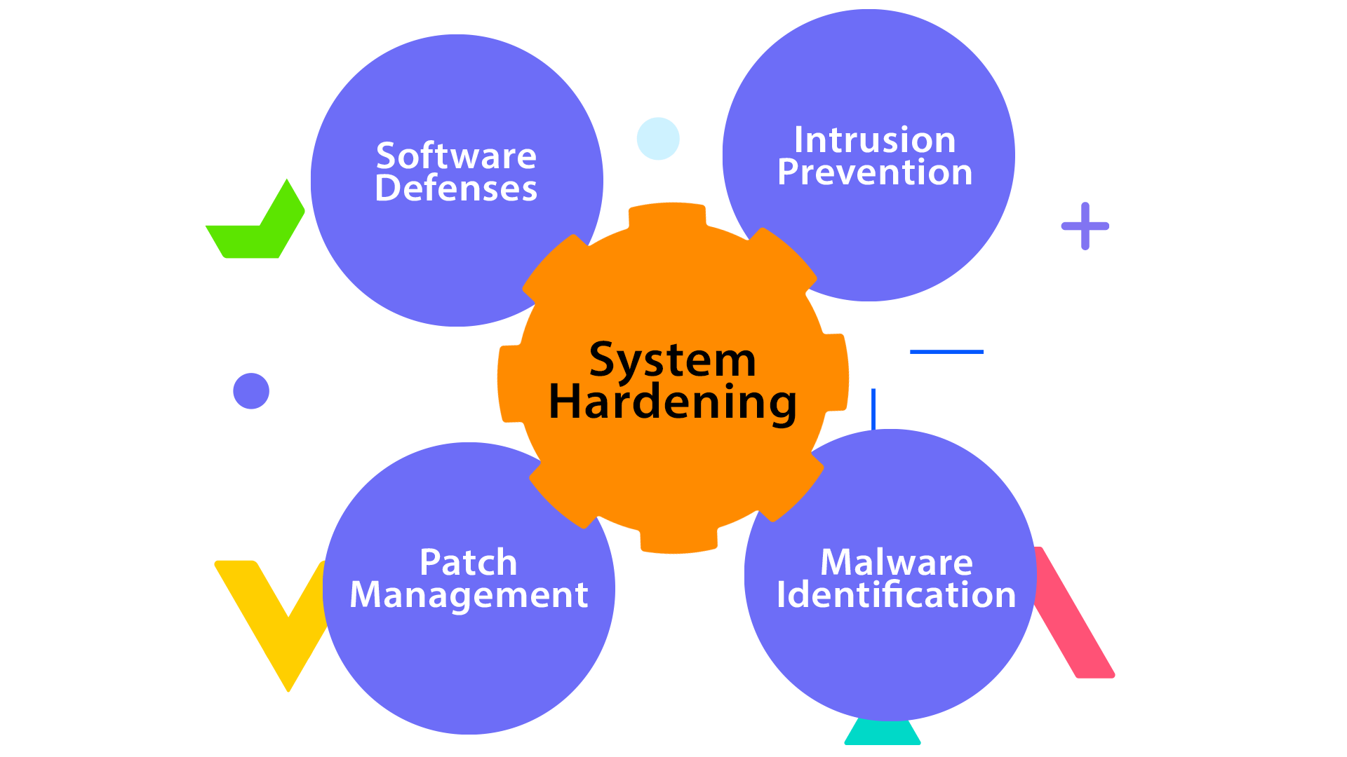
System Hardening

Slide 15
System Hardening
Removing unnecessary services and software
Applying security patches and updates
Configuring secure system settings

Slide 16
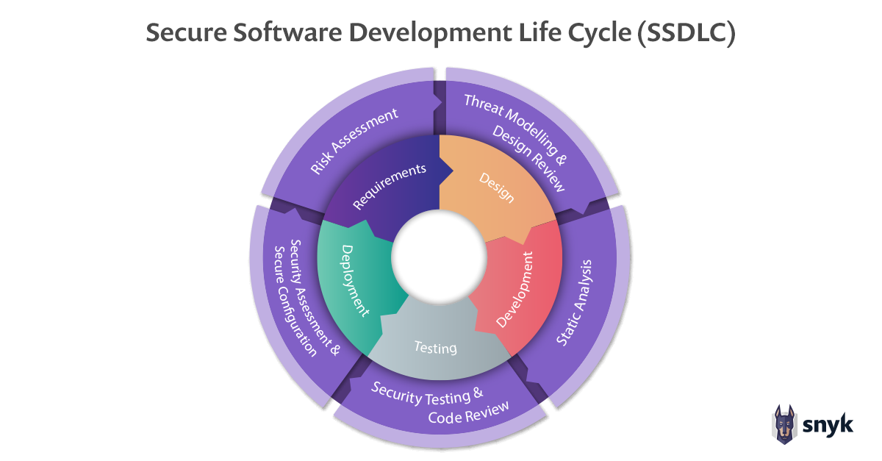
Application Security

Slide 17
Application Security
Plaintext is readable data
Ciphertext is encrypted data
Encryption and decryption use cryptographic keys

Slide 18
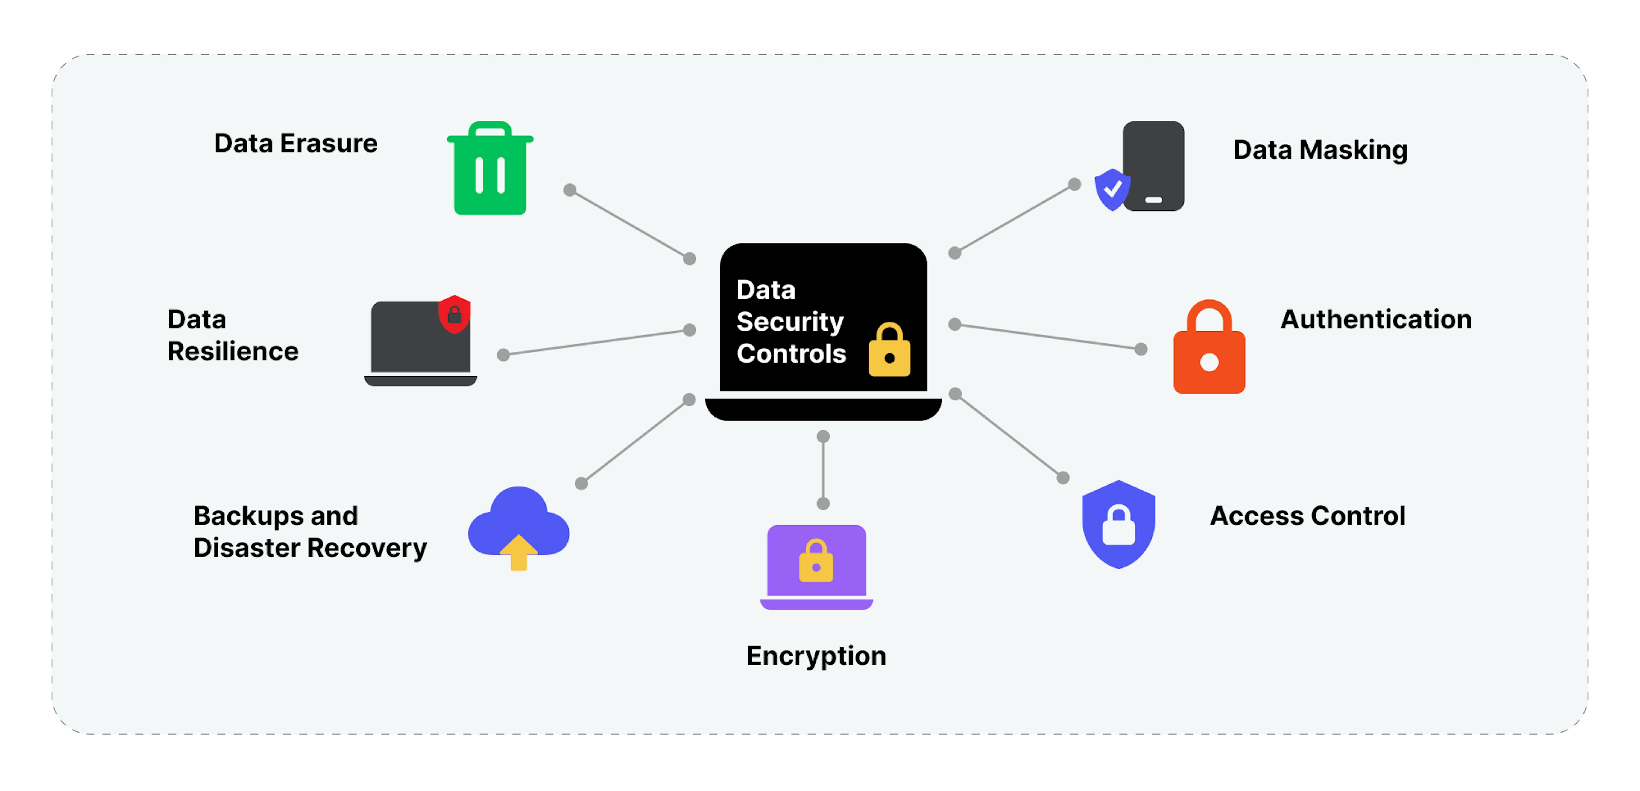
Data Security

Slide 19
Data Security
Encryption protects data at rest and in transit
Access controls limit data exposure
Backups protect against data loss

Slide 20
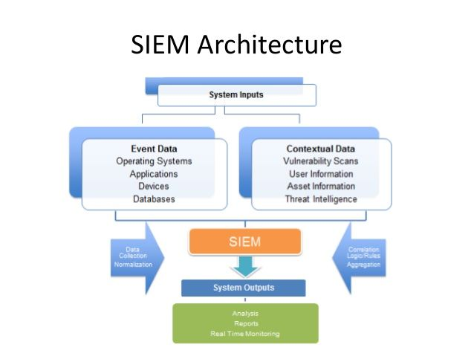
Logging and Monitoring

Slide 21
Logging and Monitoring
Logs record system and user activity
Monitoring detects suspicious behaviour
Essential for incident detection and response

Slide 22
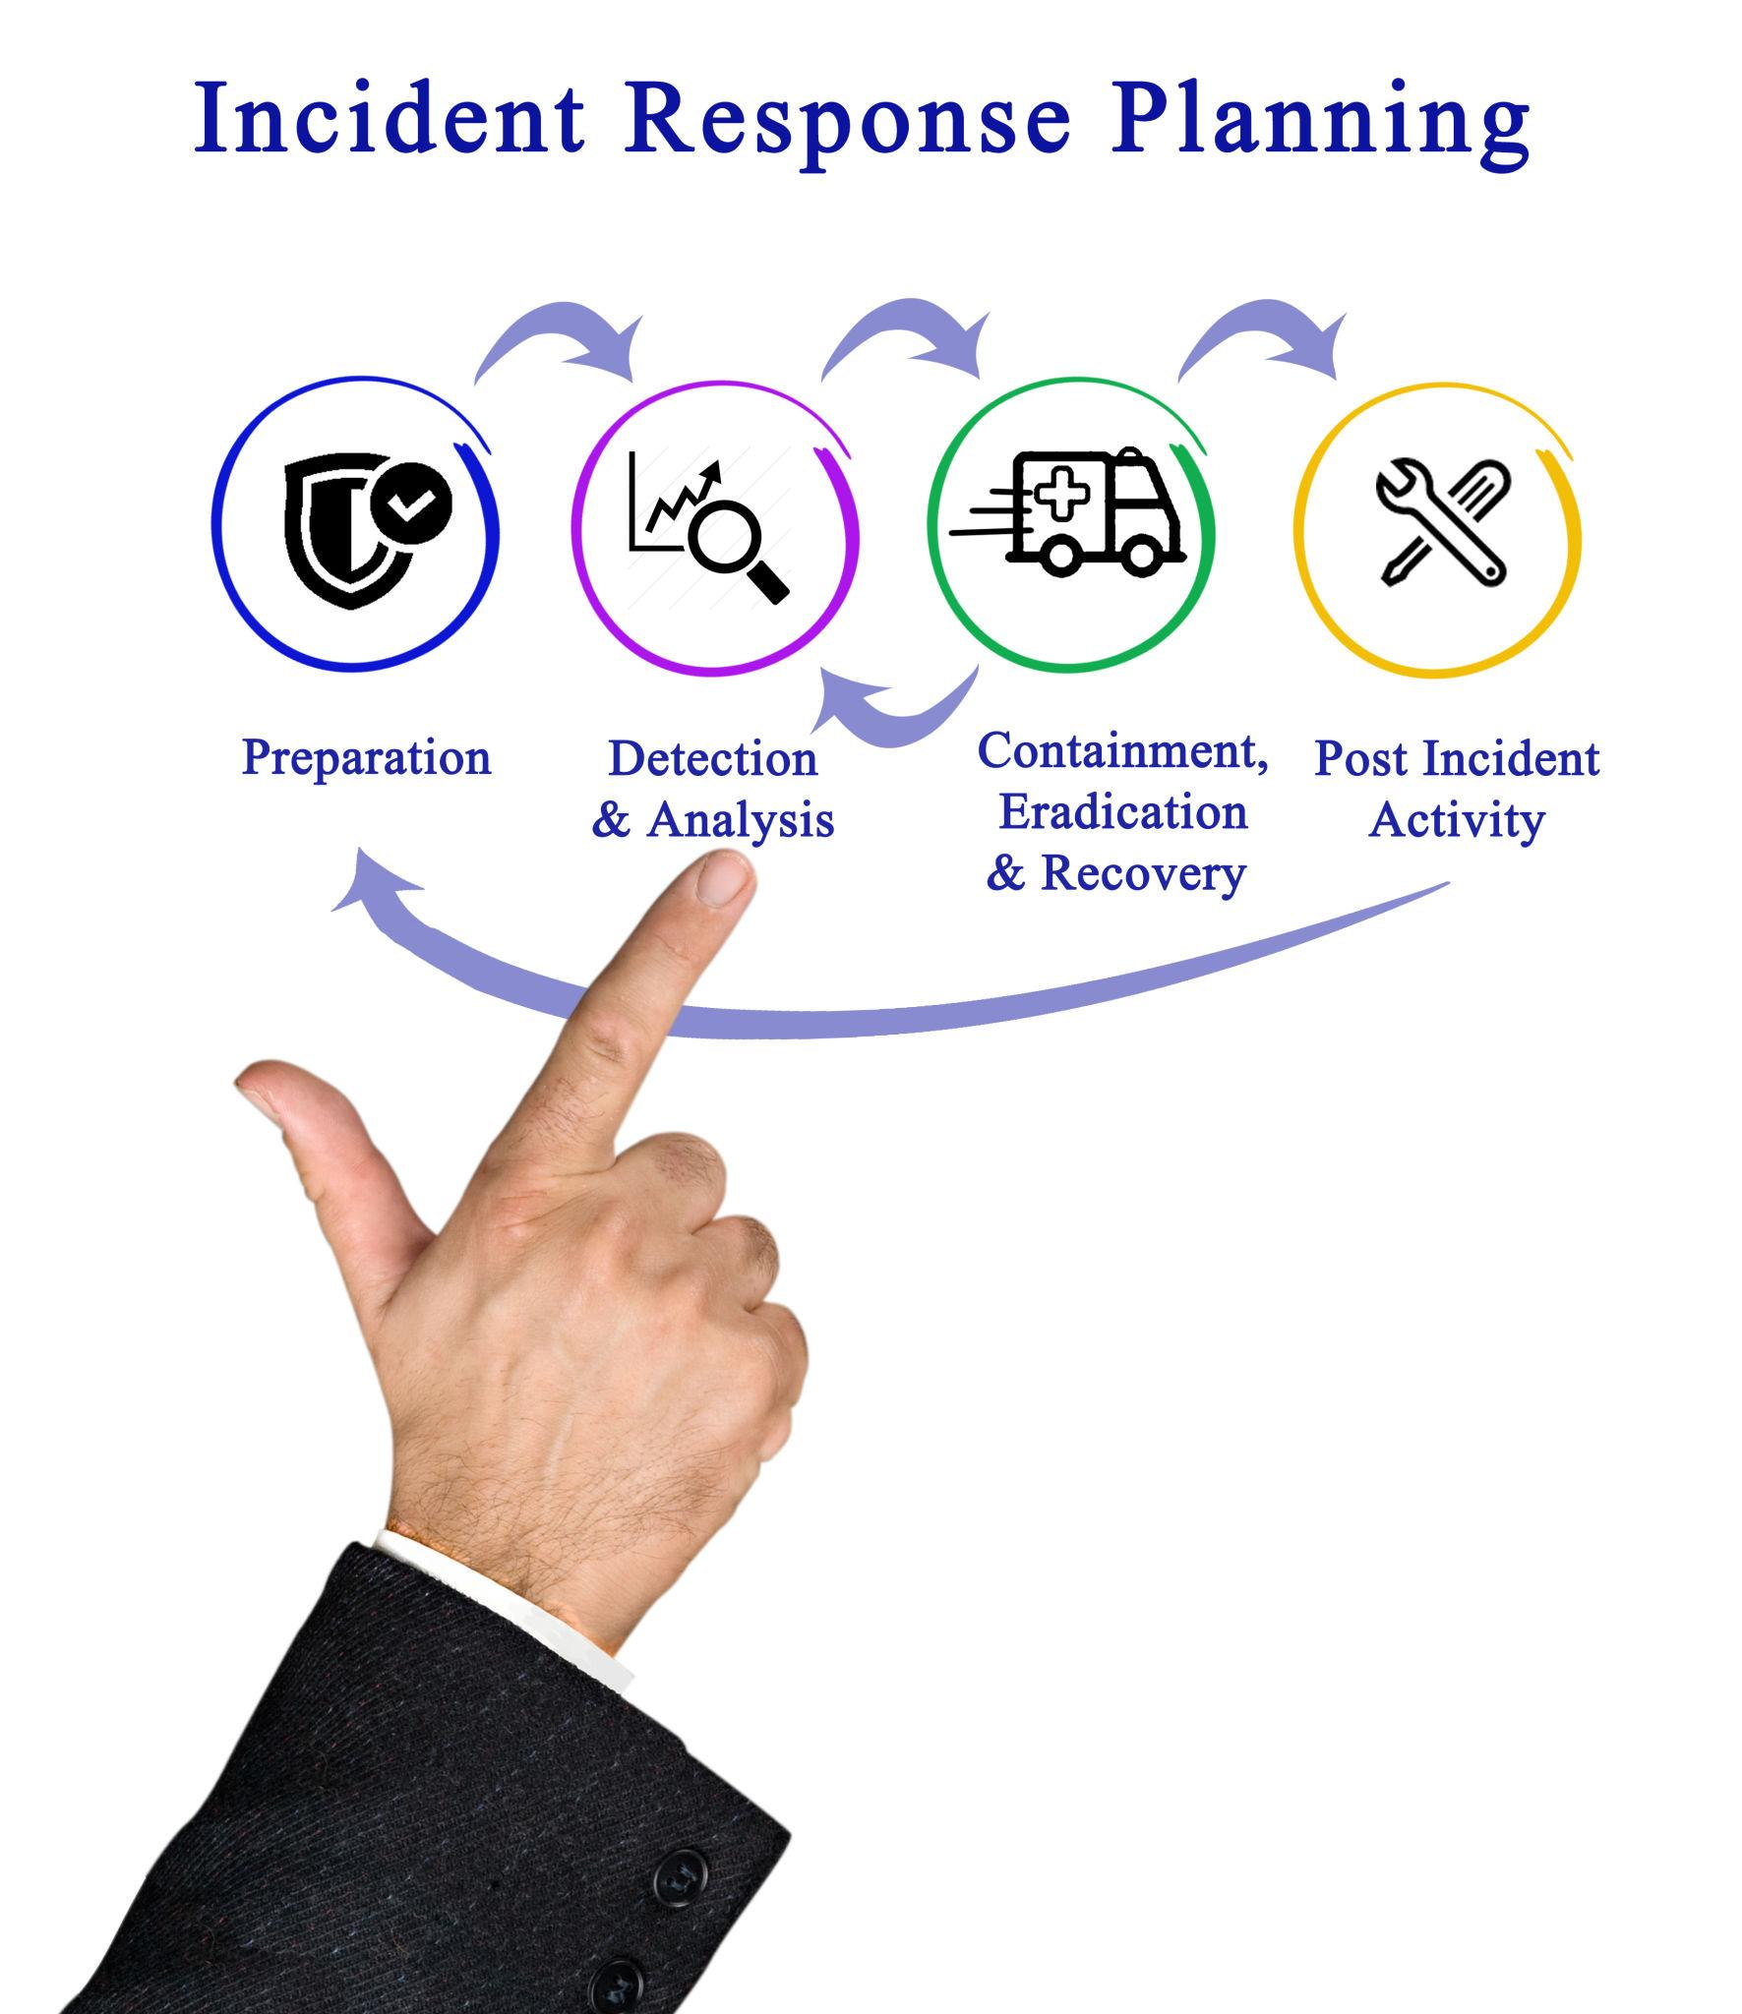
Incident Response Basics

Slide 23
Incident Response Basics
Preparation before incidents occur
Detection and analysis of security events
Containment, eradication, and recovery

Slide 24
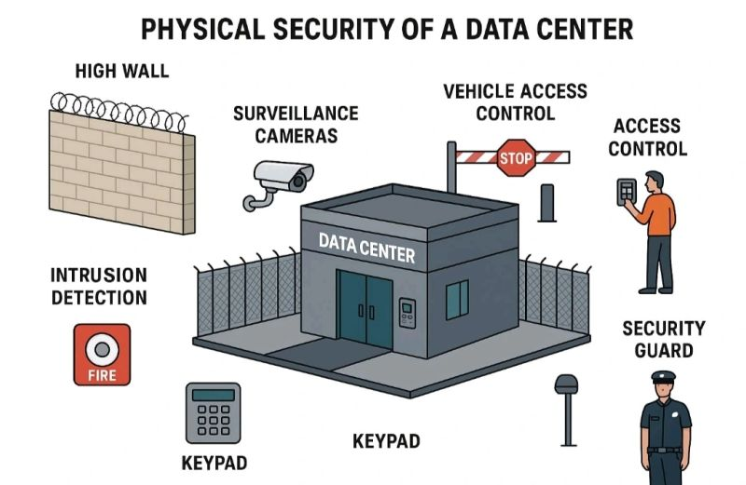
Physical Security Controls

Slide 25
Physical Security Controls
Protect physical assets and facilities
Includes locks, access cards, and surveillance
Supports overall cyber security

Slide 26
Common Practical Security Failures
Weak passwords and poor authentication
Unpatched systems
Lack of monitoring and response planning

